Slide 1
Predicting Reddit Post Popularity
Ron Richardson, Christina Eusanio, Bill Fisher

Slide 2

Reddit: Background
Self proclaimed, “Front page of the internet”
Fifth most popular website according to Amazon Alexa’s data
Massive collection of forums where users can share content and news
Users interact via likes, shares, comments, and voting

Slide 3

Problem Statement and Importance
Posts are sorted according to a post score
Post scores are aggregates of upvotes and downvotes
Hypothesis: Using various features available in the API, we can predict which posts are deemed “popular” based on post content
Predicting post score is important to advertisers and users alike

Slide 4
Collecting Data and Feature Engineering
Using the Reddit API, we pulled roughly 1400 posts from six unique subreddits
r/Aww, r/Conspiracy, r/AskMen, r/AskWomen, r/Knitting, r/Fitness
Collected various features including post_score, num_words, num_comments, post_edited, etc.
Engineered additional features including bi and tri grams, post_title_sentiment, and various counts for title and post words

Slide 5

Defining the Metrics
Out of the first 1000 posts, defined popular as a post_score at or above the 75th percentile
To deal with inequality of classes, we added in more posts with scores at or above the respective subreddit’s score threshold

Slide 6

Preprocessing the Data
Remove columns that are not predictive
Num_comments, post_gilded, columns with all Null values or only a single value
Convert categorical columns to numeric values
Scale features to ensure magnitudes/units/ranges do not contaminate results
Split data into train, validation, and test sets

Slide 7
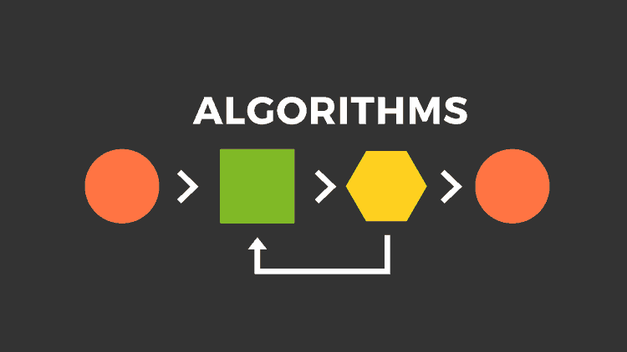
Selecting Prediction Algorithms
Started with various binary classifiers on train and validation data
Logistic Regression, Decision Tree Classifier, Random Forest Classifier, Naïve Bayes Classifier, K Nearest Neighbors Classifier, Support Vector Machine Classifiers
Once we were satisfied with results, we combined the top two classifiers using ensemble methods to create our final model

Slide 8
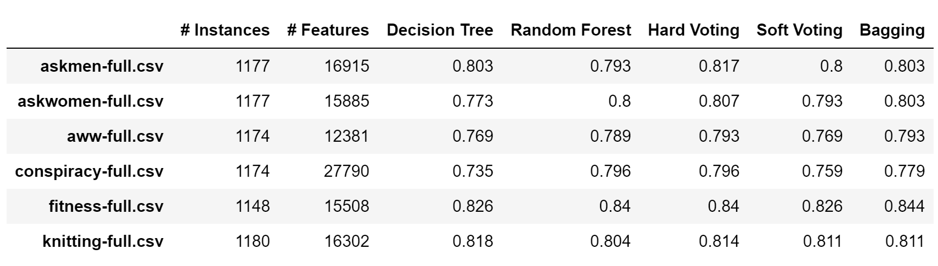
Model Results
For all six subreddits, the Decision Tree Classifier, Random Forest Classifier, and the Naïve Bayes Classifier classified above random
The Decision Tree Classifier and the Random Forest Classifier posted the best results
Ensemble methods were added but had minimal effects
Model test results suggest that predicting popular Reddit posts is possible using the Reddit API and machine learning techniques

Slide 9
Future Work
Collect more data
Use more subreddits
Collect more post content
Using older posts
Analyze relevant metdata

Slide 10
Questions?
Code and data available at: https://github.com/rer145/cis572-project/tree/master/data

